Slide 1


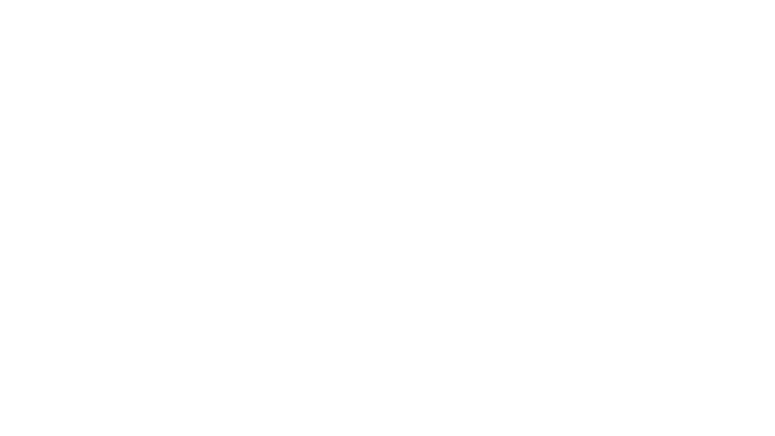
methodology 1)Split the data into features and target variable 2) Split the data into training and testing sets 3)Initialize models 4) Train models 5)Make predictions 6)Calculate accuracy score 7)Create a bar graph to compare accuracies

Slide 2
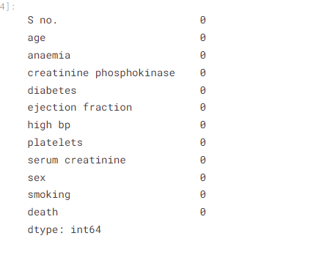
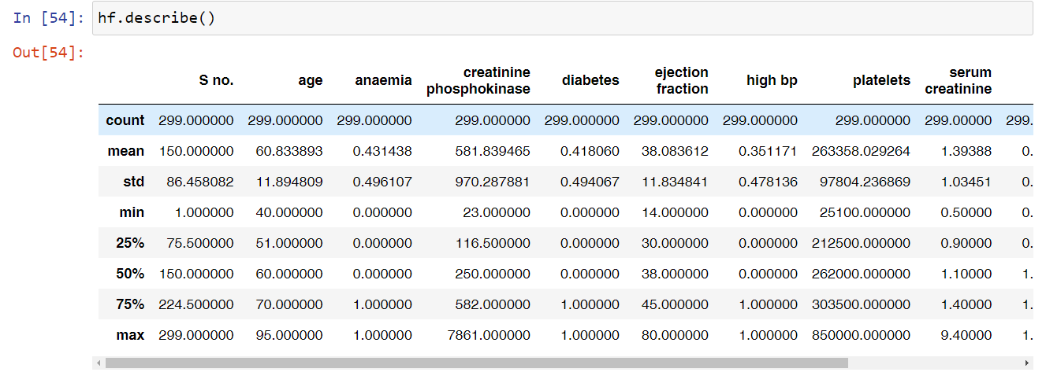
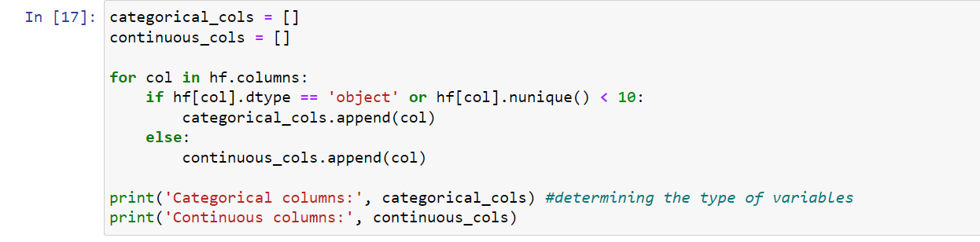
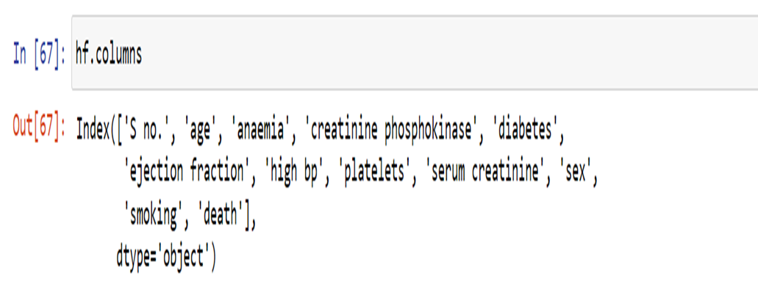
DATA preprocessing

Slide 3

Models used The Machine Learning models used for this project are: 1) randomforest classifier 2) Regression ( Logistic ) 3) Decision Tree

Slide 4
RANDOMFOREST CLASSIFIER: Random forest classifiers are called "random forests" because they are composed of multiple decision trees, and each tree is built using a random subset of the training data and a random subset of the features. This randomness helps to reduce overfitting and improve generalization. The basic idea behind a random forest classifier is to combine the predictions of multiple decision trees to make a final prediction. Each decision tree in the random forest is trained independently on a different subset of the training data. During the training process, at each node of a decision tree, a random subset of features is considered for splitting, and the best split is chosen based on certain criteria (such as Gini impurity or information gain).

